Slide 1

9. Radiation & Antennas
7e Applied EM by Ulaby and Ravaioli

Slide 2
Overview

Slide 3
Radiation
What is radiation?
Radiant energy released by certain electromagnetic processes
Classical theory: electromagnetic radiation consists of electromagnetic waves
Quantum theory: electromagnetic radiation consists of photons
Source of radiation: accelerated charged particles

Slide 4
Fields of Moving Charges
A good resource
http://phet.colorado.edu/sims/radiating-charge/radiating-charge_en.html
A static charge produces static electric field at the speed of light
When a charge is moving, the generated electric fields change accordingly
When the charge moves with acceleration, the generated electric fields exhibit oscillating natures, which will in turn generate magnetic fields and form electromagnetic fields

Slide 5
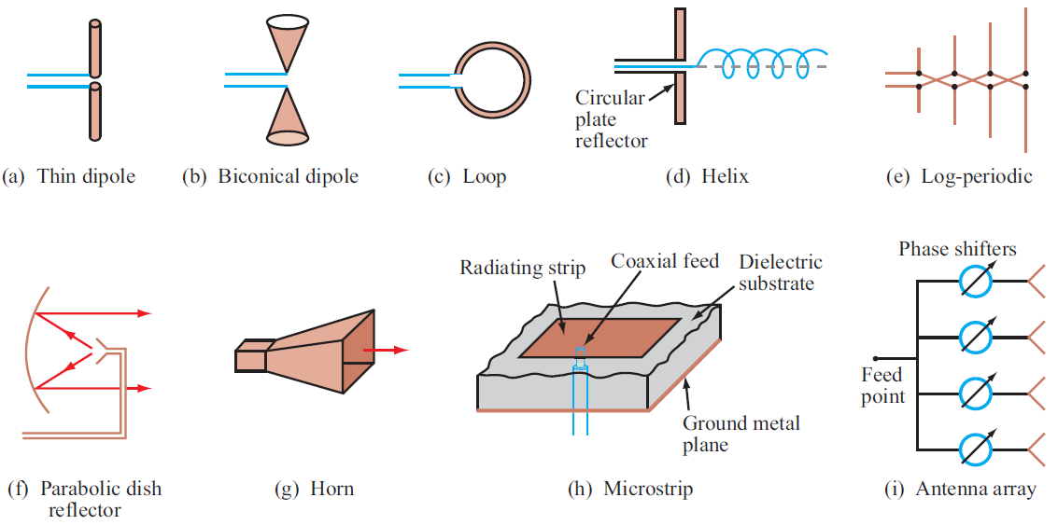
Examples of Antennas

Slide 6
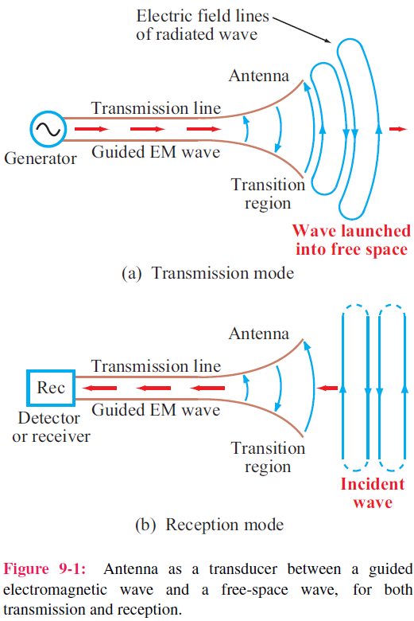
Antenna Properties
1. An antenna is a transducer that converts a guided wave propagating on a transmission line into an electromagnetic wave propagating in an unbounded medium (usually free space), or vice versa.
2. Most antennas are reciprocal devices, exhibiting the same radiation pattern for transmission as for reception.
3. Being a reciprocal device, an antenna, when operating in the receiving mode, can extract from an incident wave only
that component of the wave whose electric field matches the antenna polarization state.

Slide 7
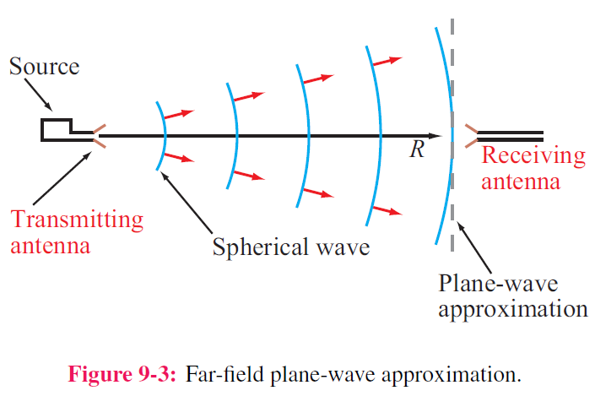
Far-Field Approximation
1. In close proximity to a radiating source, the wave is spherical in shape, but at a far distance, it becomes approximately a plane wave as seen by a receiving antenna.
2. The far-field approximation simplifies the math.
3. The distance beyond which the far-field approximation is valid is called the far-field range (will be defined later).

Slide 8
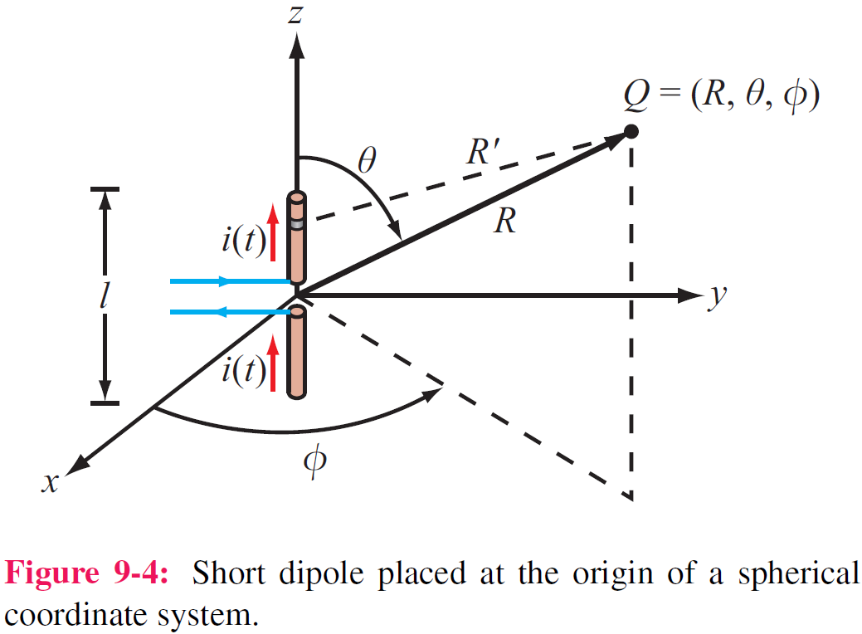
The Hertzian Dipole
A Hertzian dipole is a thin, linear conductor whose length l is very short compared with the wavelength λ; l should not exceed λ/50.
This restriction allows us to treat the current along the length of the conductor as constant, even though it has to decay to zero at the ends of the wire.
The field of the entire antenna may be obtained by integrating
the fields from all these differential antennas, with the proper
magnitudes and phases taken into account

Slide 9
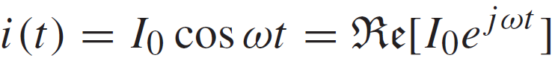
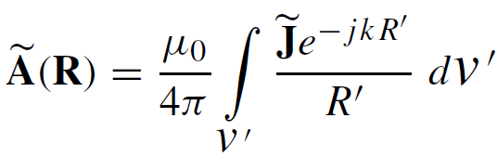
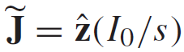
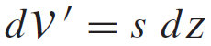
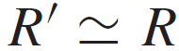
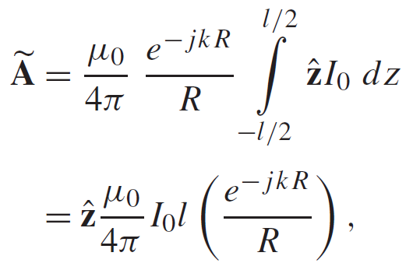
Fields Radiated by Hertzian Dipole
Current along dipole:
See p. 259, 303
Magnetic Vector Potential:
With:
Given A, we can determine E and H

Slide 10
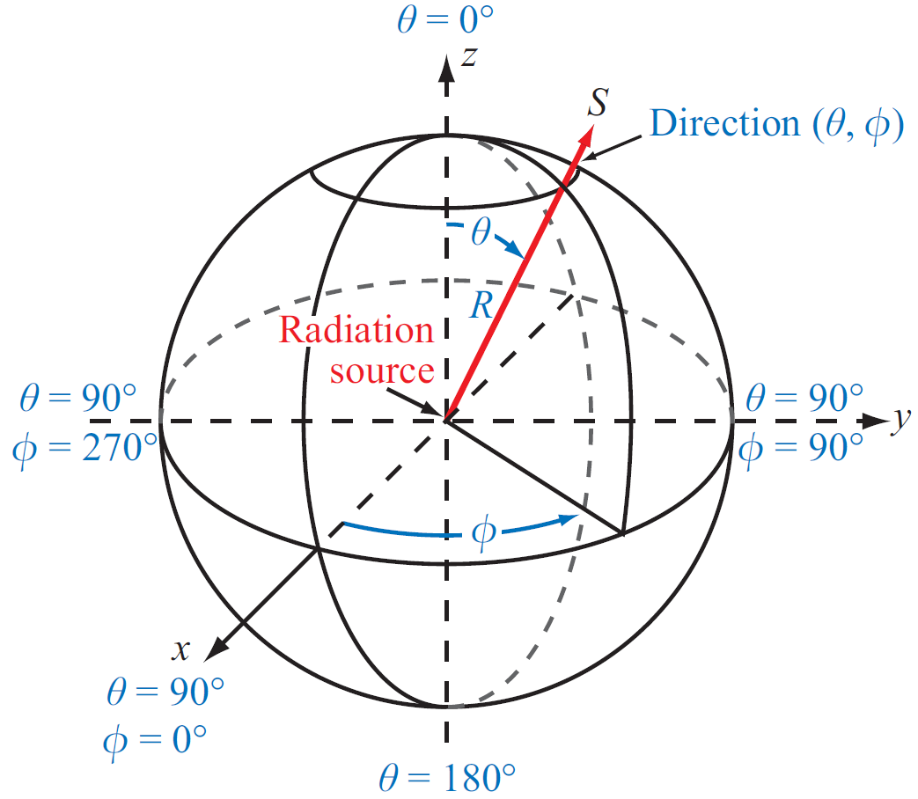
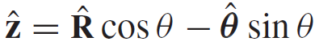
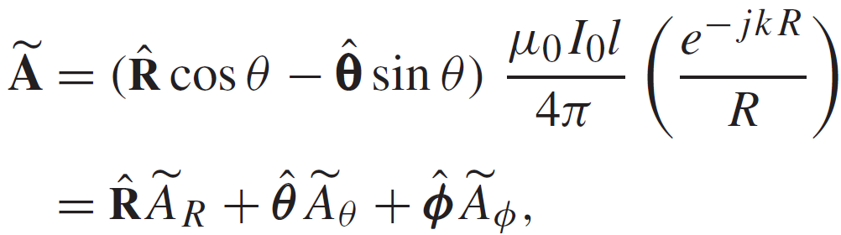
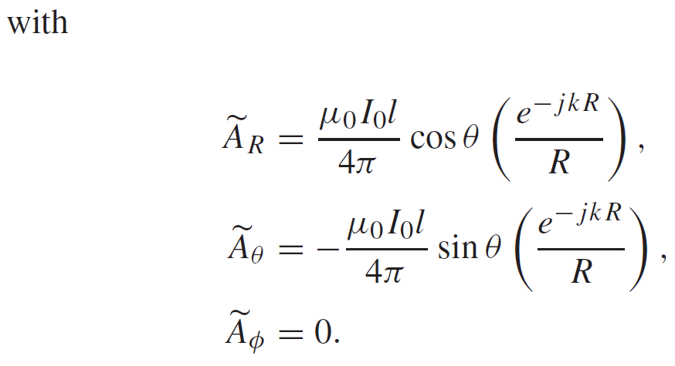
Fields Radiated by Hertzian Dipole (cont.)
Upon converting z to spherical coordinates:
We have:

Slide 11
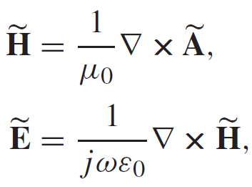
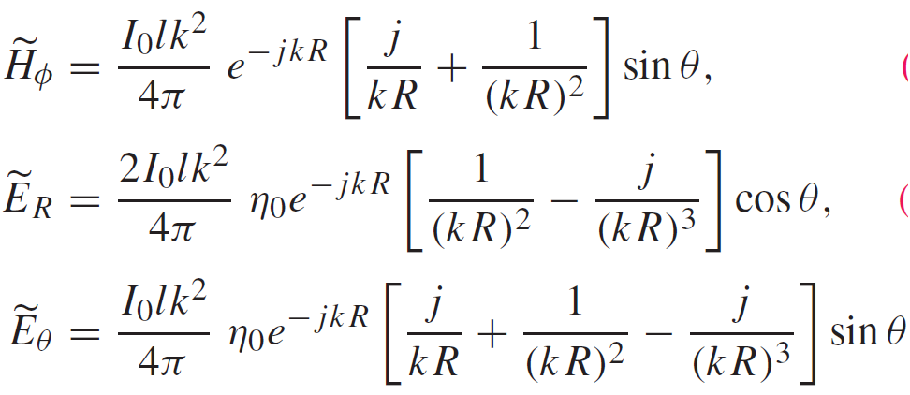
Fields Radiated by Hertzian Dipole (cont.)
Application of:
leads to:

Slide 12
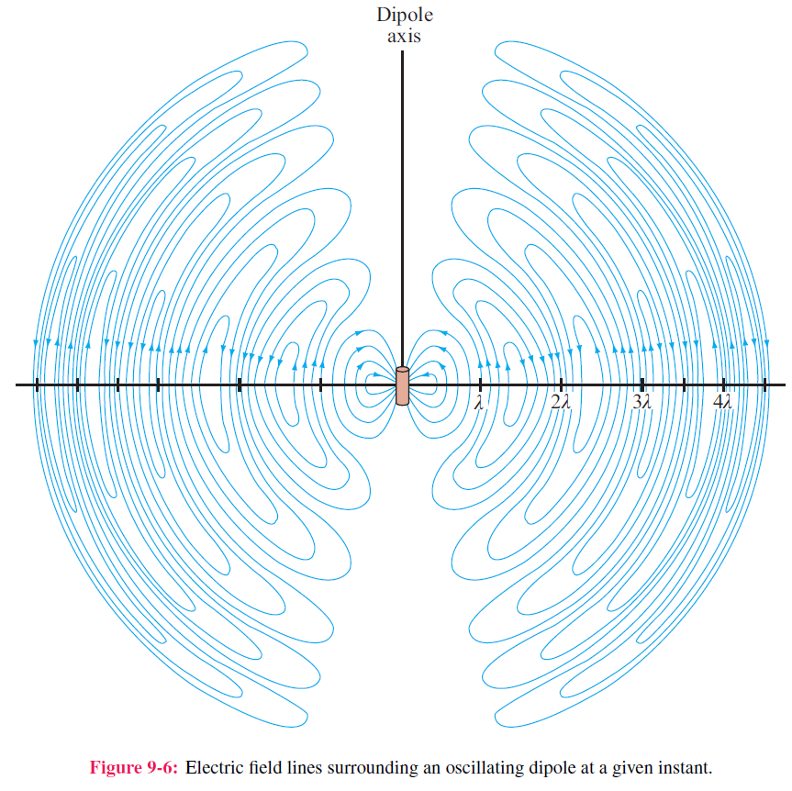
Radiated Electric Field

Slide 13
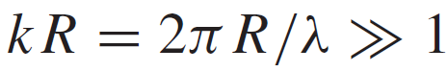
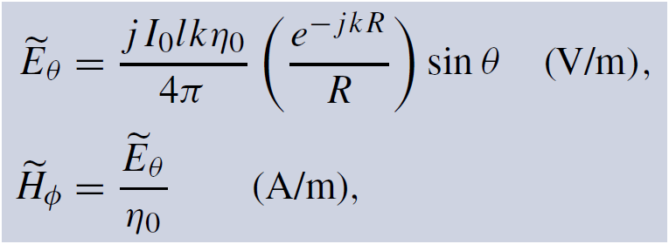
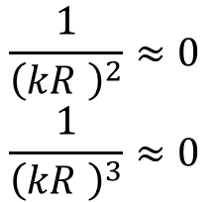
Hertzian Dipole—Far-Field Approximation
At any range R:
$$\frac{1}{{\left(kR \right)}^{2}}≈0$$
$$\frac{1}{{\left(kR \right)}^{3}}≈0$$
At

Slide 14
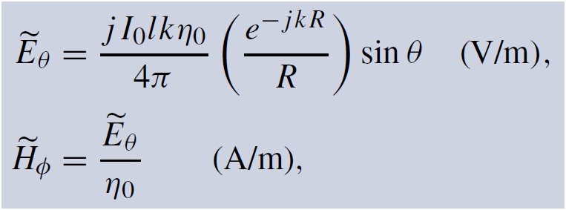
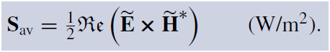
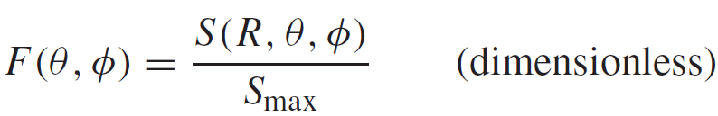
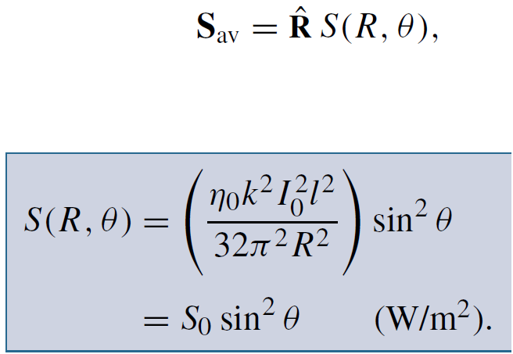
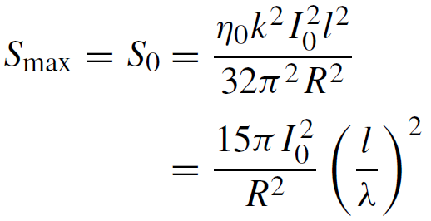
Normalized Radiation Intensity
Electric and Magnetic Fields
Normalized Radiation Intensity
Average Power Density
W/m²

Slide 15
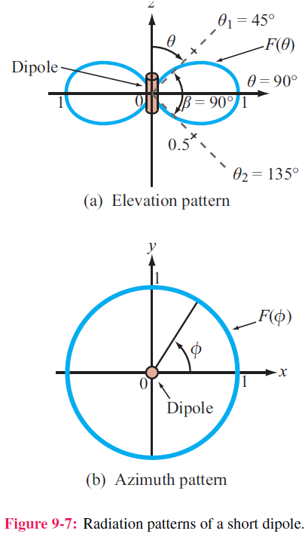
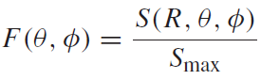
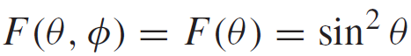
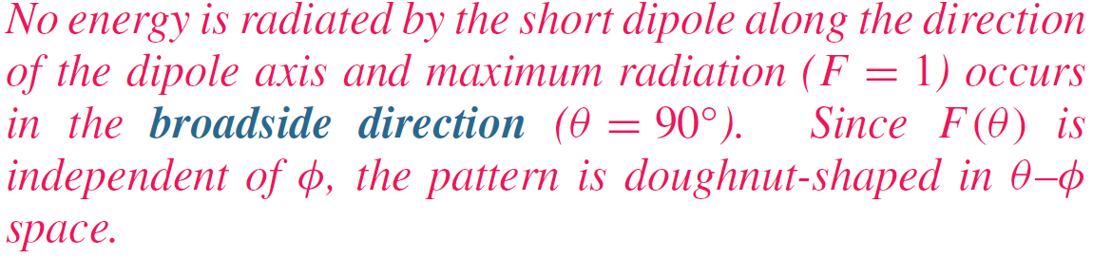
Radiation Pattern of Hertzian Dipole

Slide 16
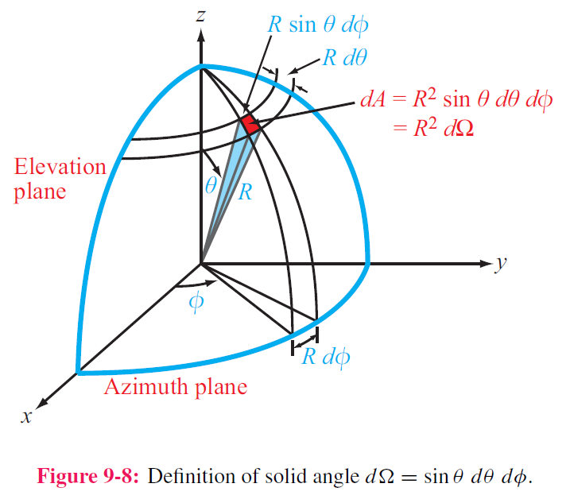
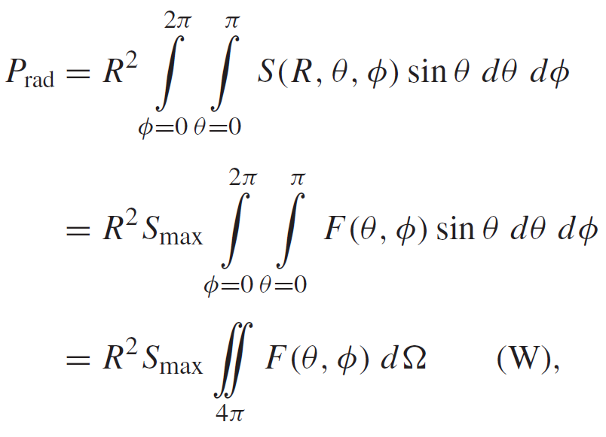
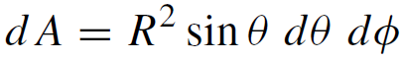
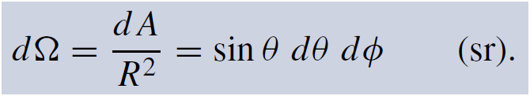
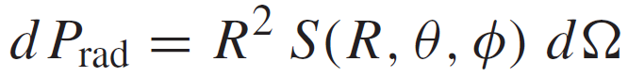
Antenna Radiation Characteristics
1. By virtue of reciprocity, a receiving antenna has the same directional antenna pattern as the pattern that it exhibits when operated in the transmission mode.
2. Total Radiated Power
Differential area
Total Radiated Power
Solid Angle
Power radiated through dA

Slide 17
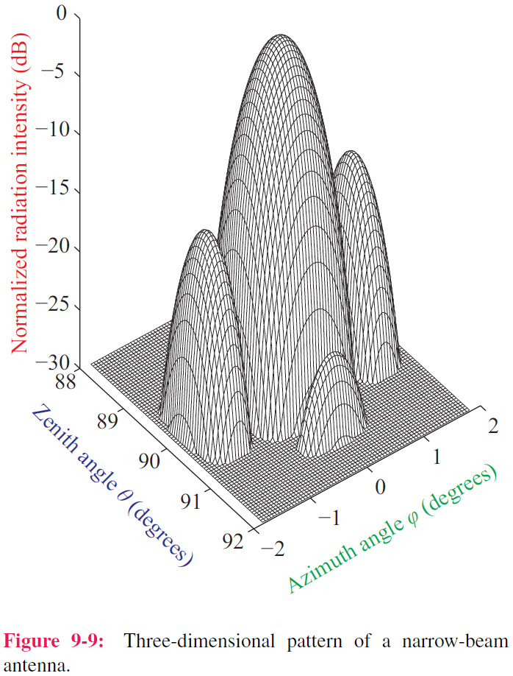
Example of 3-D Pattern
F (dB) = 10 log F
Principal planes:
1. Elevation plane (x-z and y-z planes)
2. Azimuth plane (x-y plane)

Slide 18
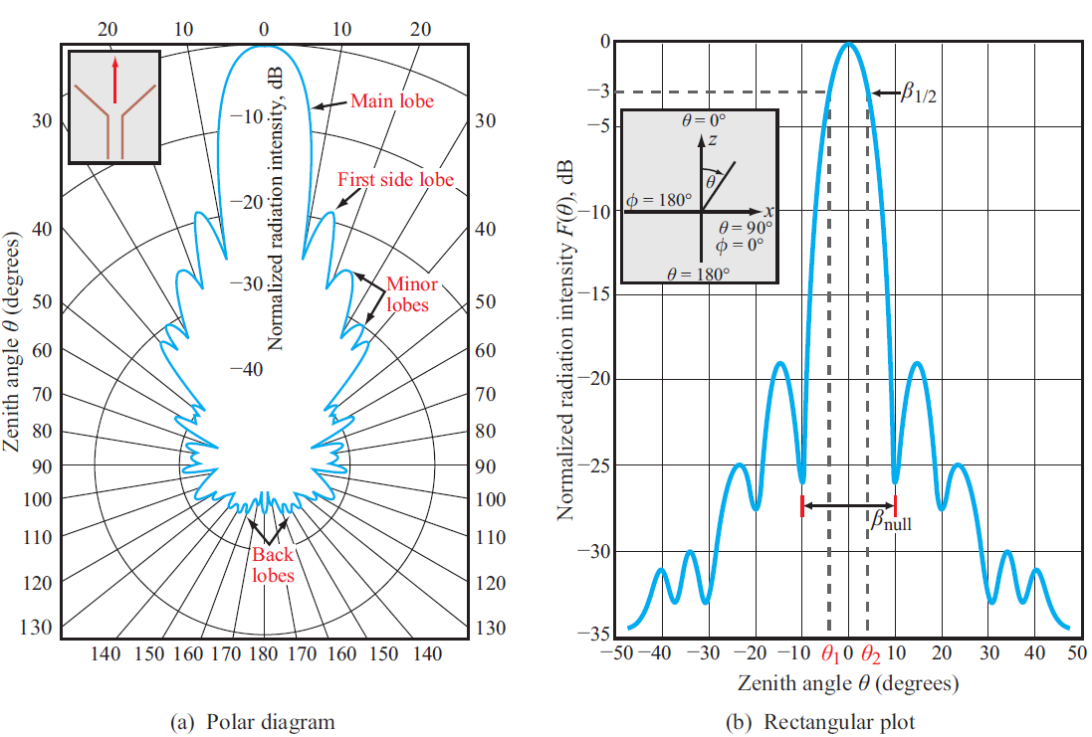
Polar and Rectangular Plots

Slide 19
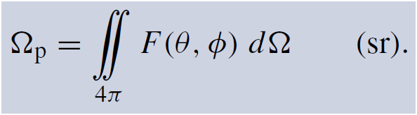
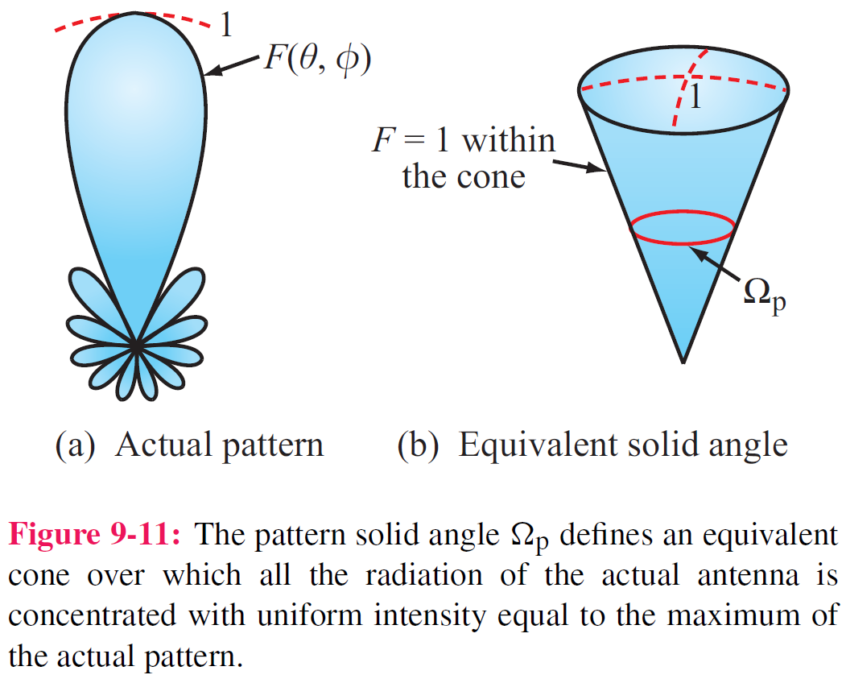
Pattern Solid Angle
steradian
Equivalent Solid Angle
See p. 412

Slide 20
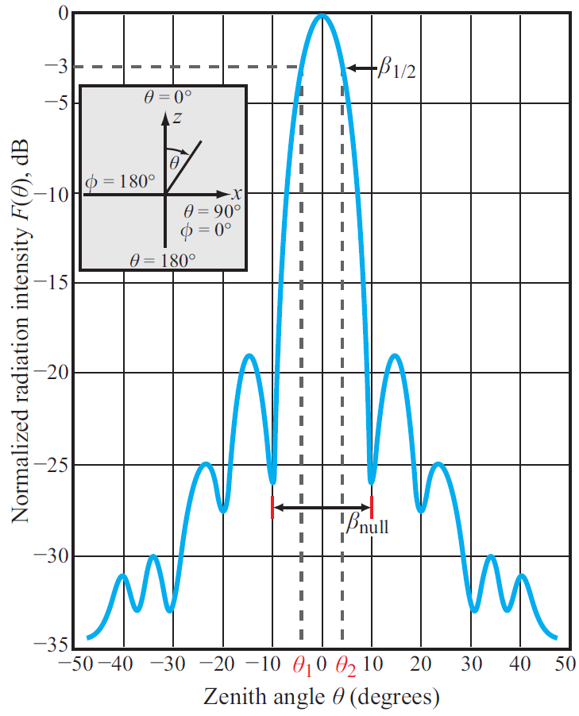
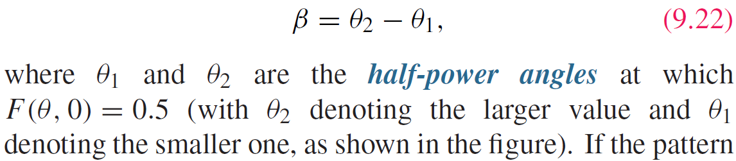
Beam Width
Half-power beamwidth
Since 0.5 corresponds to ‒3 dB, the half power beamwidth is also called the 3-dB beamwidth.

Slide 21
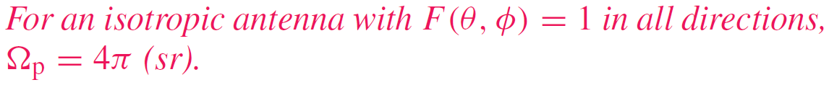
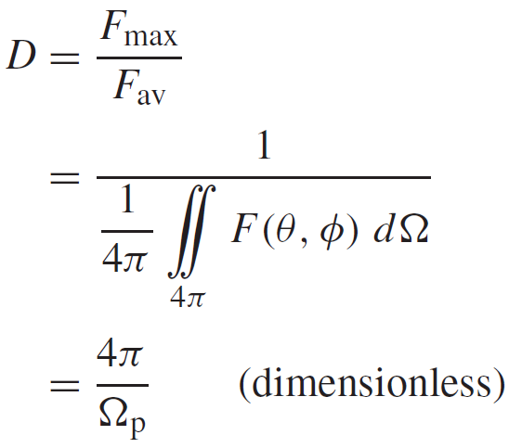
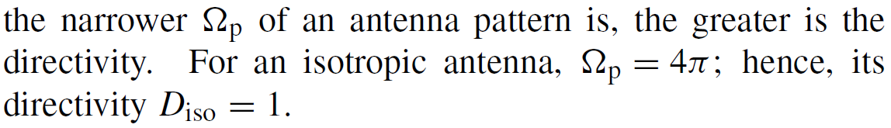

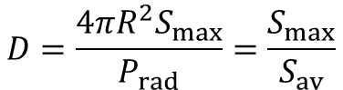
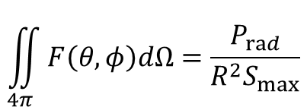
Antenna Directivity D
Antenna pattern solid angle
Maximum normalized radiation intensity = 1
Directivity
Average value of F(θ,φ) over all directions
$$\iint_{4π}{F\left(θ,φ\right)dΩ}=\frac{P_{rad}}{R^{2}S_{max}}$$
$$D≥1$$
$$D=\frac{4πR^{2}S_{max}}{P_{rad}}=\frac{S_{max}}{S_{av}}$$

Slide 22
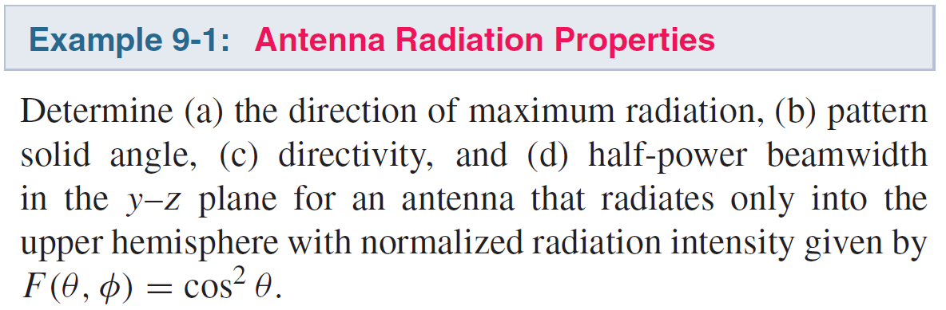
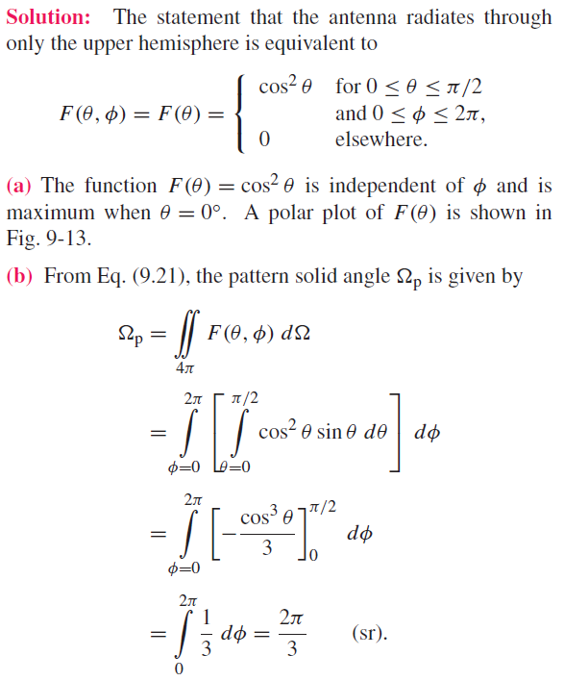
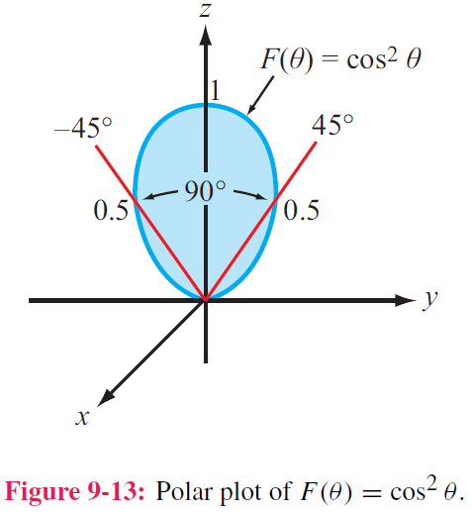
Cont.

Slide 23
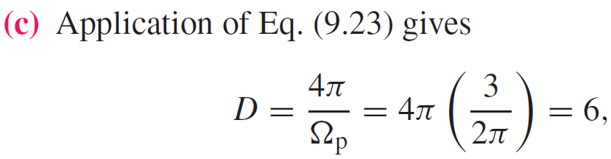
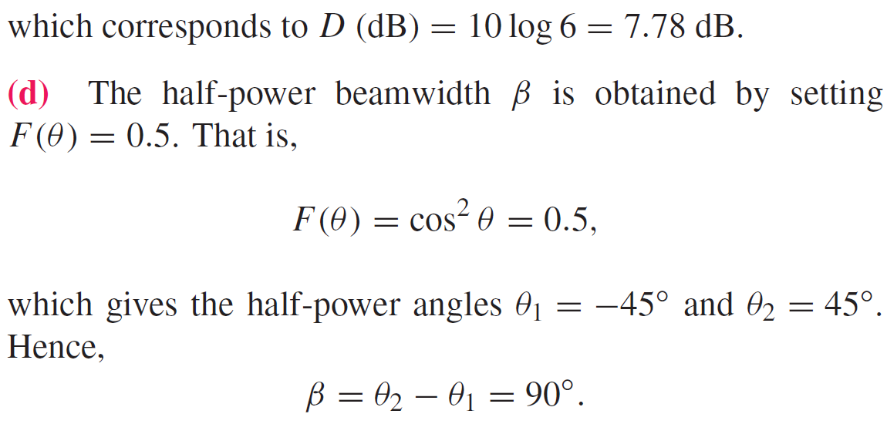
(cont.)

Slide 24


Slide 25


Radiation Efficiency and Gain
Radiation efficiency
Radiation efficiency does not consider impedance mismatch
Antenna gain G

Slide 26




Antenna Radiation and Loss Resistances
Antenna is merely a load with input impedance Z_{in}
$$Z_{in}=R_{in}+jX_{in}$$
$$P_{t}=\frac{1}{2}I_{0}^{2}R_{in}$$

Slide 27

Cont.

Slide 28



Example 9-3 (cont.)
For any antenna:
For the Hertzian dipole:

Slide 29






Half-Wave Dipole
1. Current in half-wave dipole
2. For Hertzian dipole of length l, E field is:
3. Each length element dz of half-wave dipole is like a Hertzian dipole, radiating a field
4. For the entire dipole, the total radiated field is
See p. 418

Slide 30



Half-Wave Dipole (cont.)
Integration leads to:

Slide 31


Radiation Pattern of Half-Wave Dipole
Radiation pattern resembles that of the Hertzian dipole. Its beamwidth is slightly narrower, 78 degrees compared with 90 degrees for the Hertzian dipole.

Slide 32




Other Half-Wave Dipole Properties
1. Directivity
2. Radiation Resistance
Numerical integration gives:
This is very important, because it makes it easy to match the antenna to a 75-Ω transmission line. In contrast, the radiation resistance of a dipole whose length is much shorter than a wavelength is on the order of 1 Ω or less.

Slide 33

Quarter-Wave Monopole
When placed over a conducting ground plane, a quarter-wave monopole antenna excited by a source at its base [Fig.9-15(a)] exhibits the same radiation pattern in the region above the ground plane as a half-wave dipole in free
space.
However, its radiation resistance if only half of that of a half-wave dipole, namely 36.5 Ω.
Image theory

Slide 34





Dipole of Arbitrary Length

Slide 35


Radiation Pattern of Different Dipole

Slide 36




Antenna Effective Area

Slide 37


Friis Transmission Formula
See p. 427

Slide 38


Slide 39


Example 9-4 (cont.)

Slide 40

Radiation by Aperture Antennas
Instead of calculating the radiated fields E and H at Q due to currents in the antenna, with apertures it is also possible to relate the radiated fields to the electric field distribution across the aperture.

Slide 41

Examples of Aperture Sources
Computational Approaches
a. Vector Formulation--accurate, but mathematically involved
b. Scalar Formulation—easier to implement but restricted to large aperture dimensions (relative to the wavelength)
2. Both methods are applicable at all wavelengths, including the visible spectrum
3. Validity of Scalar Formulation. The key requirement for the validity of the scalar formulation is that the antenna aperture be at least several wavelengths long along each of its principal dimensions.
We will limit our treatment to the scalar formulation.

Slide 42



Relating Radiated Field to Aperture Distribution
Far Field Condition
Radiated E Field
Aperture Distribution

Slide 43





Rectangular Aperture with Uniform Distribution
Uniform distribution across aperture
Scalar formulation leads to:
The sinc function is maximum when its argument is zero; sinc(0) = 1.

Slide 44

Examples of Radiation Patterns
Circular aperture has circular beam
In each principal plane, beamwidth is inversely proportional to antenna dimension in that plane
Cylindrical reflector has narrow beam along length direction and wide beam along its width direction

Slide 45

Directivity & Effective Area

Slide 46

Antenna Arrays

Slide 47
Antenna Arrays
An antenna array to a continuous aperture is analogous to digital data to analog. By controlling the signals fed into individual array elements, the pattern can be shaped to suit the desired application.
Also, through the use of electronically controlled solid-state
phase shifters, the beam direction of the antenna array can
be steered electronically by controlling the relative phases
of the array elements.
This flexibility of the array antenna has led to numerous
applications, including electronic steering and multiple-beam
generation.

Slide 48



Array Pattern
Power density radiated by the entire array
Power density radiated by an individual element
Array Factor
The array factor represents the far-field radiation intensity of the N elements, had the elements been isotropic radiators.

Slide 49


Cont.

Slide 50



Example 9-5 (cont.)

Slide 51


Example 9-5 (cont.)

Slide 52




Array Pattern for Uniform Phase Distribution
Any array with identical elements
Array with uniform phase
Array with uniform phase and amplitude

Slide 53



Slide 54





Electronic Steering
With linear phase:
with:
Angle at which the steered pattern is a maximum

Slide 55

Examples of Steered Patterns
Note that the pattern widens as it is steered away from broadside

Slide 56


Array Feeding
The electrical lengths of the lines can be changed by changing the broadside frequency

Slide 57



Cont.

Slide 58

Example 9-8 (cont.)
Cont.

Slide 59

Example 9-8 (cont.)

Slide 60

Summary

